Slide 1
ITS200 Website Presentation
Travis and Camden

Slide 2
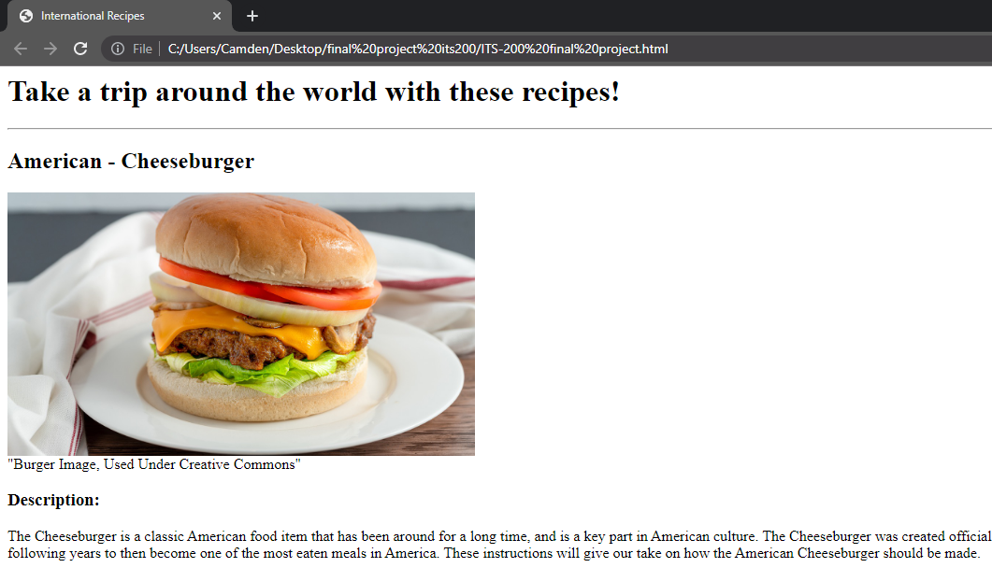
What We Did
We decided to put together a site that gives the user recipes from around the world, with an emphasis on interaction.

Slide 3
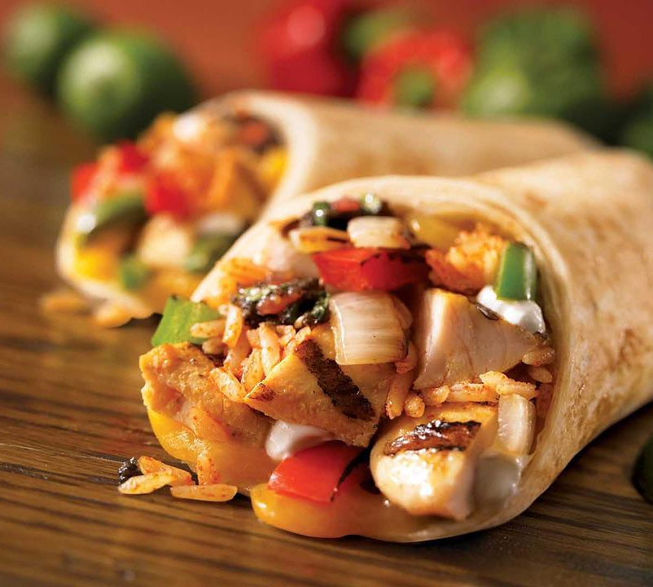
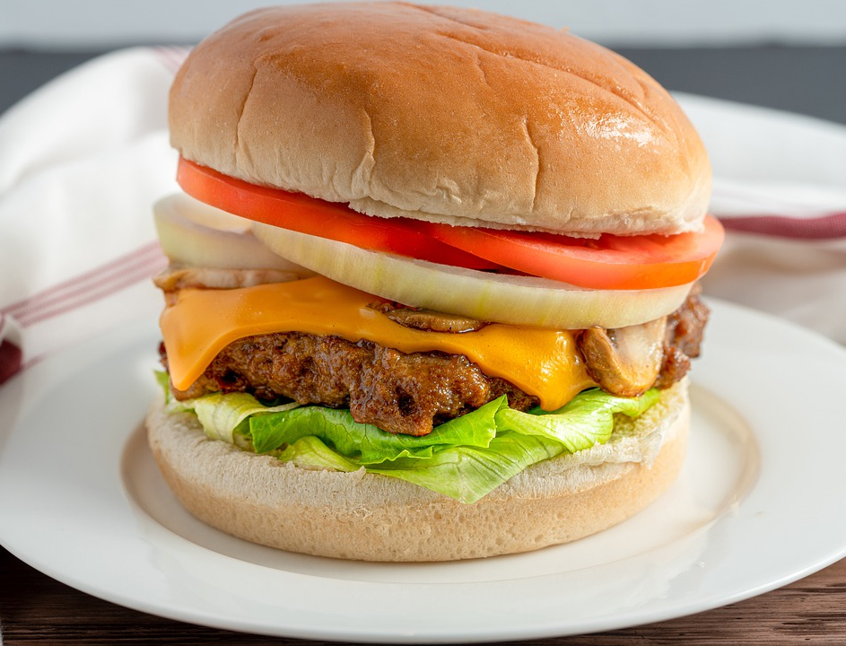
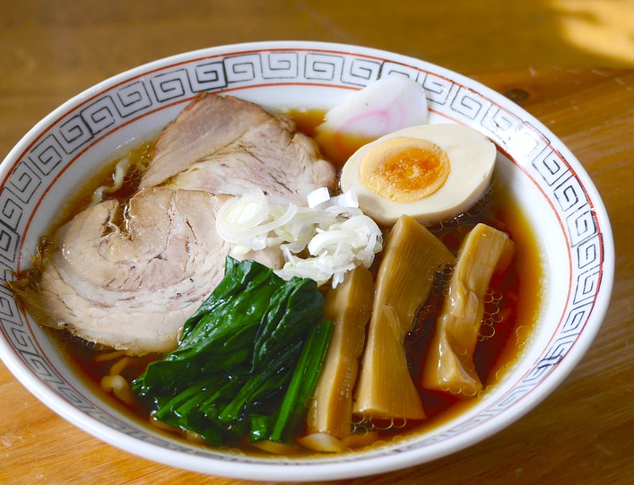
What Recipes Did We Choose?
USA – Cheeseburger
Mexico – Burrito
Japan – Ramen Noodles

Slide 4

Horizontal Rule
These were used between different recipes to separate sections, giving a better visual look.

Slide 5
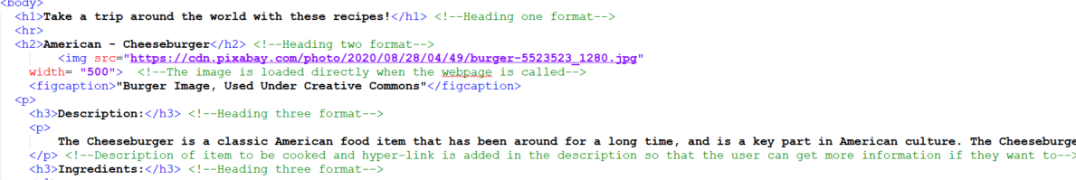
Three Headings of Different Sizes
We Used H1, H2, and H3 on our website.

Slide 6
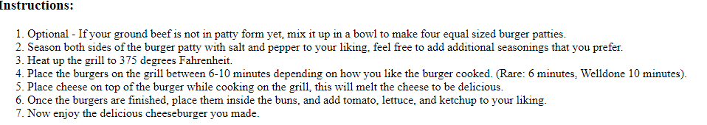
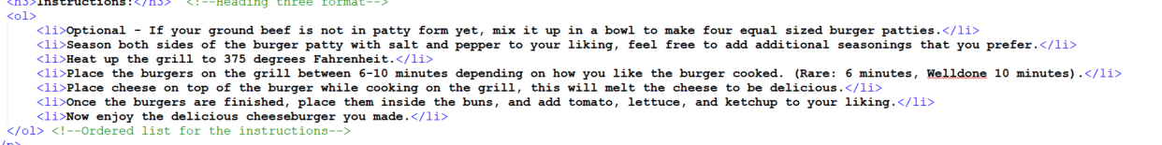
Ordered List
We included Three Ordered Lists, one for each recipe to showcase the steps to make said food.

Slide 7
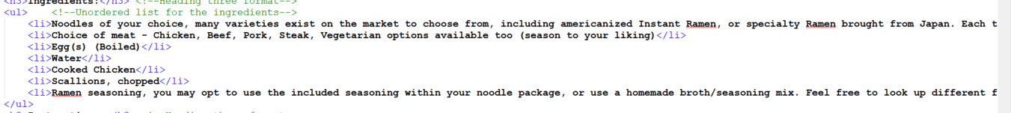
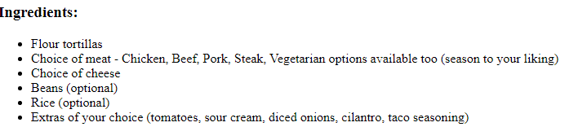
Unordered List
We included Three Unordered Lists, one for each recipe to showcase the ingredients used to make said food.

Slide 8
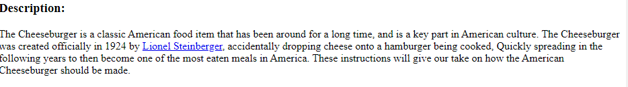
Paragraphs
We decided to make a description paragraph of each recipe, including information such as the history behind said food

Slide 9
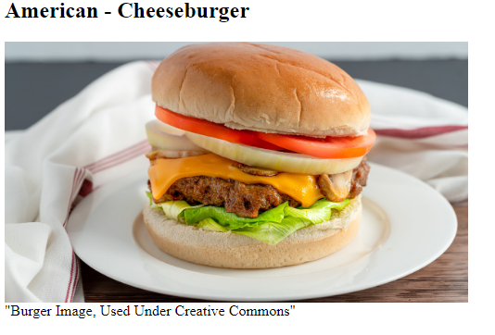

Images
We decided to place one image for each recipe, a creative commons photo to showcase said food item. Each shot also has a caption underneath to give further details.

Slide 10

Hyperlink
We added Three Separate Hyperlinks, one for each recipe to the Wiki page for said food item. This can give the user more information if they so choose to.

Slide 11
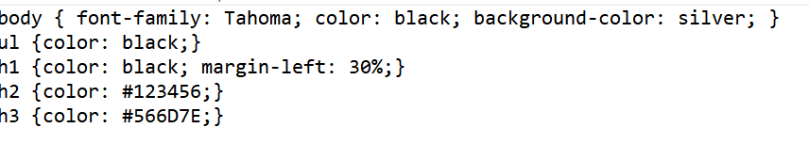
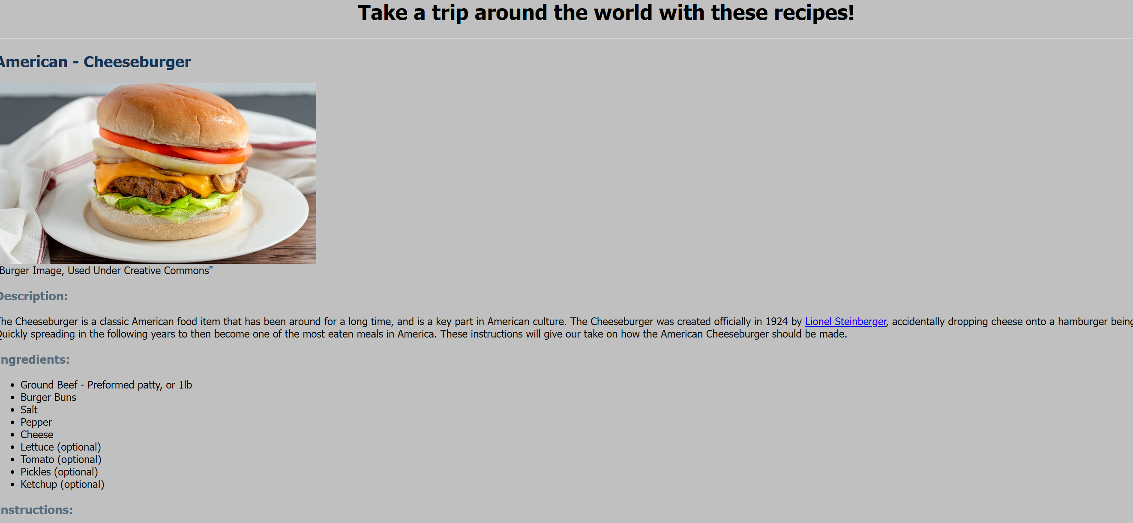
CSS Properties
We implemented Five different CSS Properties to improve the visual experience of the website.

Slide 12
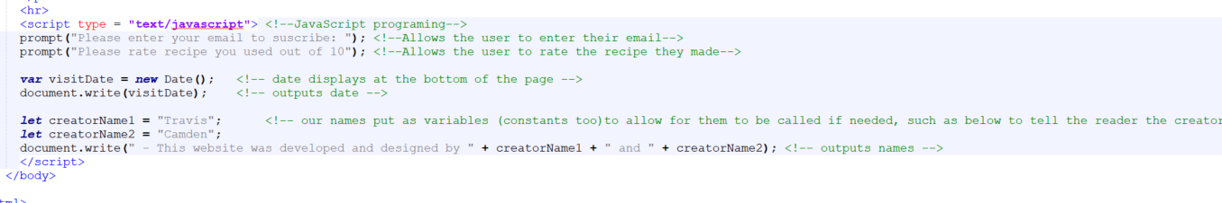
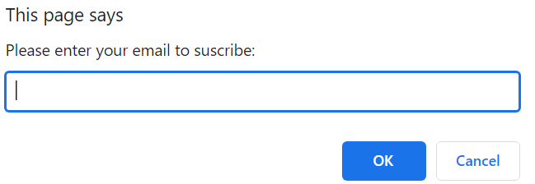
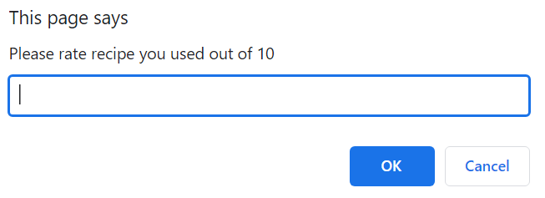
JavaScripting Elements
We added 4 unique JavaScripting Elements to our website to enhance the user experience.

Slide 13
Website In Action!
Let's look into the special features of the site!

